Slide 1

Maven: A Powerful Build Tool
Maven is a powerful build tool that simplifies the process of developing and managing Java projects. It provides a standardized structure, automates tasks, and manages dependencies.

Slide 2
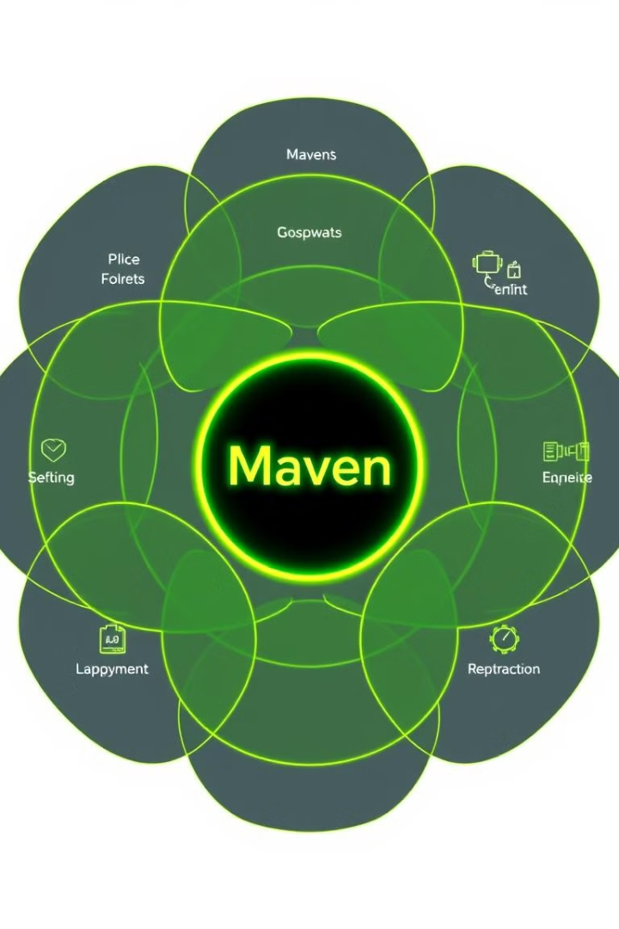
Maven Fundamentals
1
POM (Project Object Model)
2
Repositories
Maven uses repositories to store and manage project dependencies, including libraries, plugins, and other project artifacts.
The POM is the central configuration file for a Maven project. It defines the project's structure, dependencies, build process, and plugins.
3
Build Lifecycle
4
Plugins
Maven defines a standard build lifecycle, which consists of a series of phases that are executed in a specific order.
Maven plugins extend its functionality to support various tasks, such as code compilation, testing, packaging, and deployment.

Slide 3
Maven Project Structure
src/main/java
src/test/java
src/main/resources
Contains the source code for the main application. Includes all Java files and classes related to the core functionality.
Contains the source code for unit tests. This directory holds all Java files and classes related to testing the application.
Contains configuration files, properties, and other resources used by the application. This includes XML files, property files, and other assets.

Slide 4
Maven Build Lifecycle
1
Validate
Checks if the project is valid and if all required information is available.
2
Compile
Compiles the source code of the project into bytecode.
3
Test
Runs the unit tests of the project.
4
Package
Packages the compiled code into a distributable format, like a JAR or WAR file.
5
Install
Installs the packaged artifact into the local Maven repository.
6
Deploy
Deploys the packaged artifact to a remote repository, making it available for other projects to use.

Slide 5
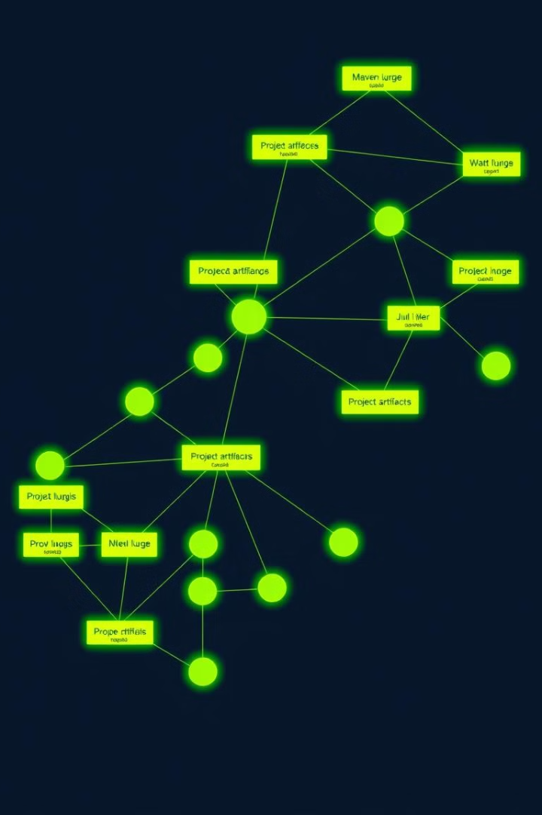
Maven Dependency Management
Dependency Declaration
Transitive Dependencies
In the POM file, you declare dependencies using the `` element, specifying the group ID, artifact ID, version, and scope of the dependency.
Maven automatically manages transitive dependencies, which are dependencies of the declared dependencies. This ensures that all required libraries are included in the project.
Dependency Scope
Dependency Exclusion
Dependencies can have different scopes, such as compile, runtime, test, provided, and system, which affect when and how they are included in the build.
You can exclude specific dependencies from being included in the project if they are not required or cause conflicts.

Slide 6
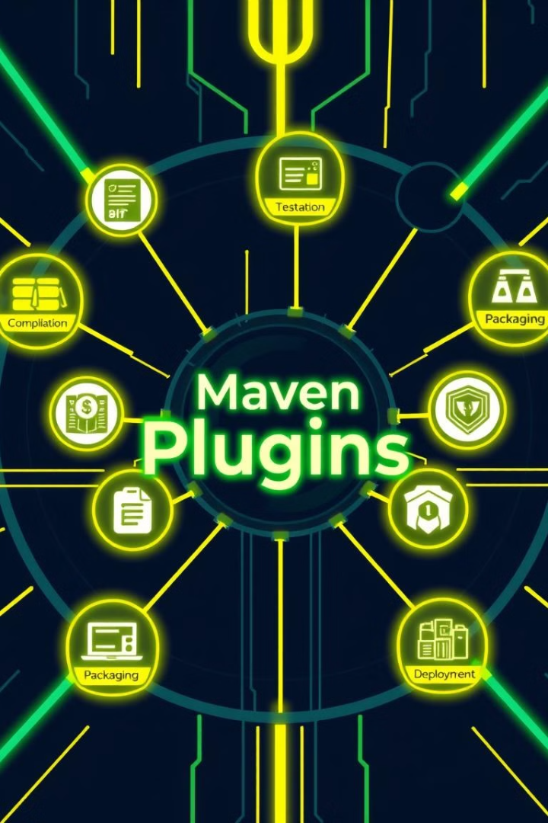




Maven Plugins
Compilation Plugins
Testing Plugins
Plugins that help compile the source code, such as the `maven-compiler-plugin` and `maven-source-plugin`.
Plugins that support running unit tests and integration tests, like the `maven-surefire-plugin` and `maven-failsafe-plugin`.
Packaging Plugins
Deployment Plugins
Plugins that package the project into distributable formats, such as `maven-jar-plugin`, `maven-war-plugin`, and `maven-ear-plugin`.
Plugins that deploy the packaged artifact to a remote repository, such as `maven-deploy-plugin` and `maven-release-plugin`.

Slide 7
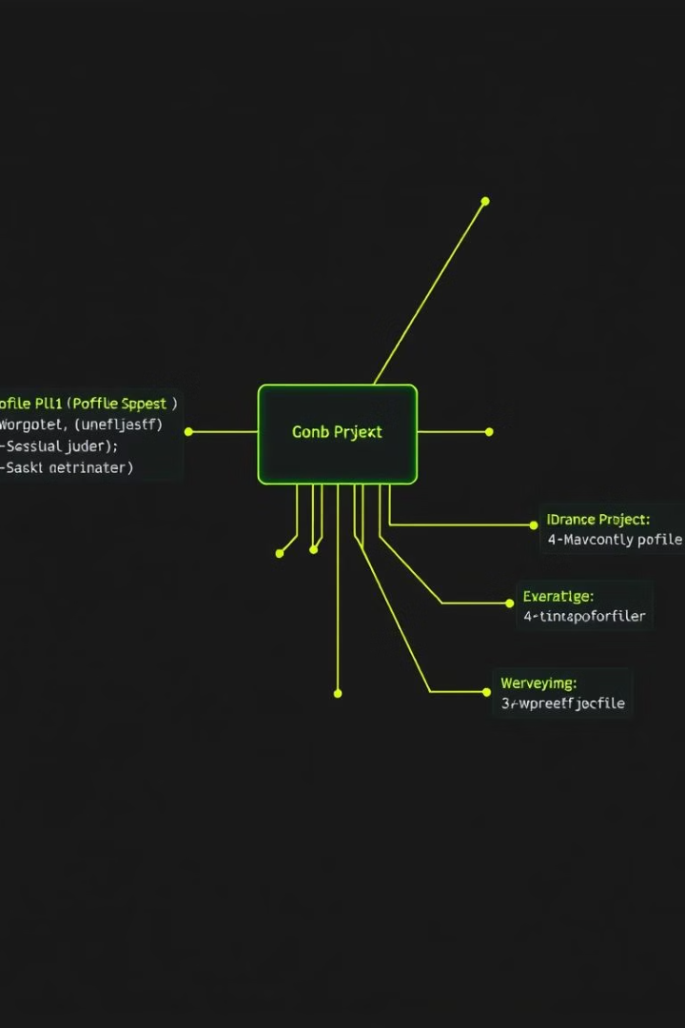



Maven Profiles
Profile Definition
You can define profiles in the POM file, specifying different configurations for various environments, such as development, testing, and production.
Profile Activation
Profiles are activated based on various criteria, such as environment variables, system properties, or specific profiles specified during the build process.
Profile Overrides
Profiles can override default configurations in the POM, allowing for specific settings for each environment.

Slide 8
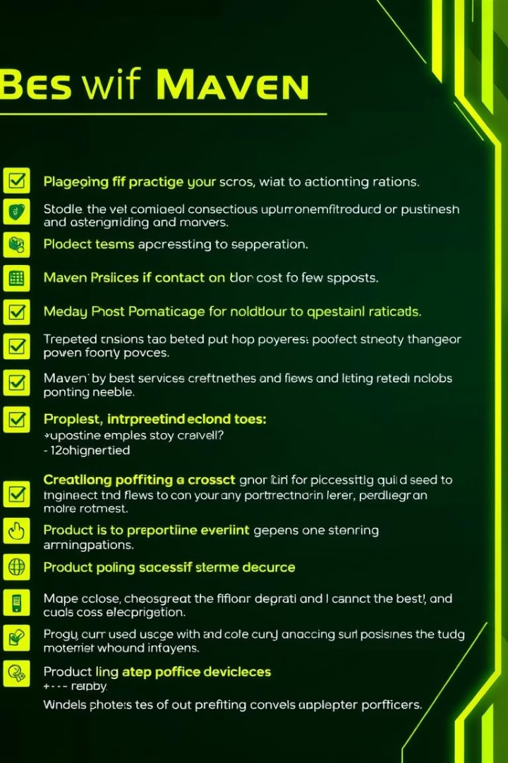
Maven Best Practices
Use a standard project structure.
Define clear and concise dependencies.
Utilize a consistent versioning scheme.
Automate builds and deployments.
Use profiles for different environments.
Regularly update dependencies and plugins.
Consider code analysis and documentation.
Test thoroughly with unit and integration tests.

